Slide 1
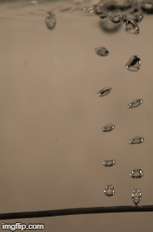
Plasmas for Life Science Applications at NC State University
Presented by:
William Murray
Graduate Advisor:
Dr. Katharina Stapelmann
Presented for:
PPPL Grad. Summer School
Princeton, NJ
08/12/2019

Slide 2
Interest in plasmas for biological, medical, and agricultural applications has grown in the 15 years
Biological: Bacteria Sterilization
Medicine: Wound Healing
Agriculture: Nitrate Injection
Kylián, O., T. Sasaki, and F. Rossi. "Plasma sterilization of Geobacillus stearothermophilus by O 2: N 2 RF inductively coupled plasma." The European Physical Journal-Applied Physics 34.2 (2006): 139-142.
Fridman, Alexander A., and Gary G. Friedman.
Plasma medicine. Chichester, UK:: John Wiley & Sons, 2013.
Judée, Florian, et al. "Plasma-activation of tap water using DBD for agronomy applications: Identification and quantification of long lifetime chemical species and production/consumption mechanisms." Water research 133 (2018): 47-59.

Slide 3


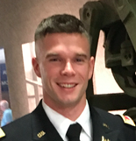

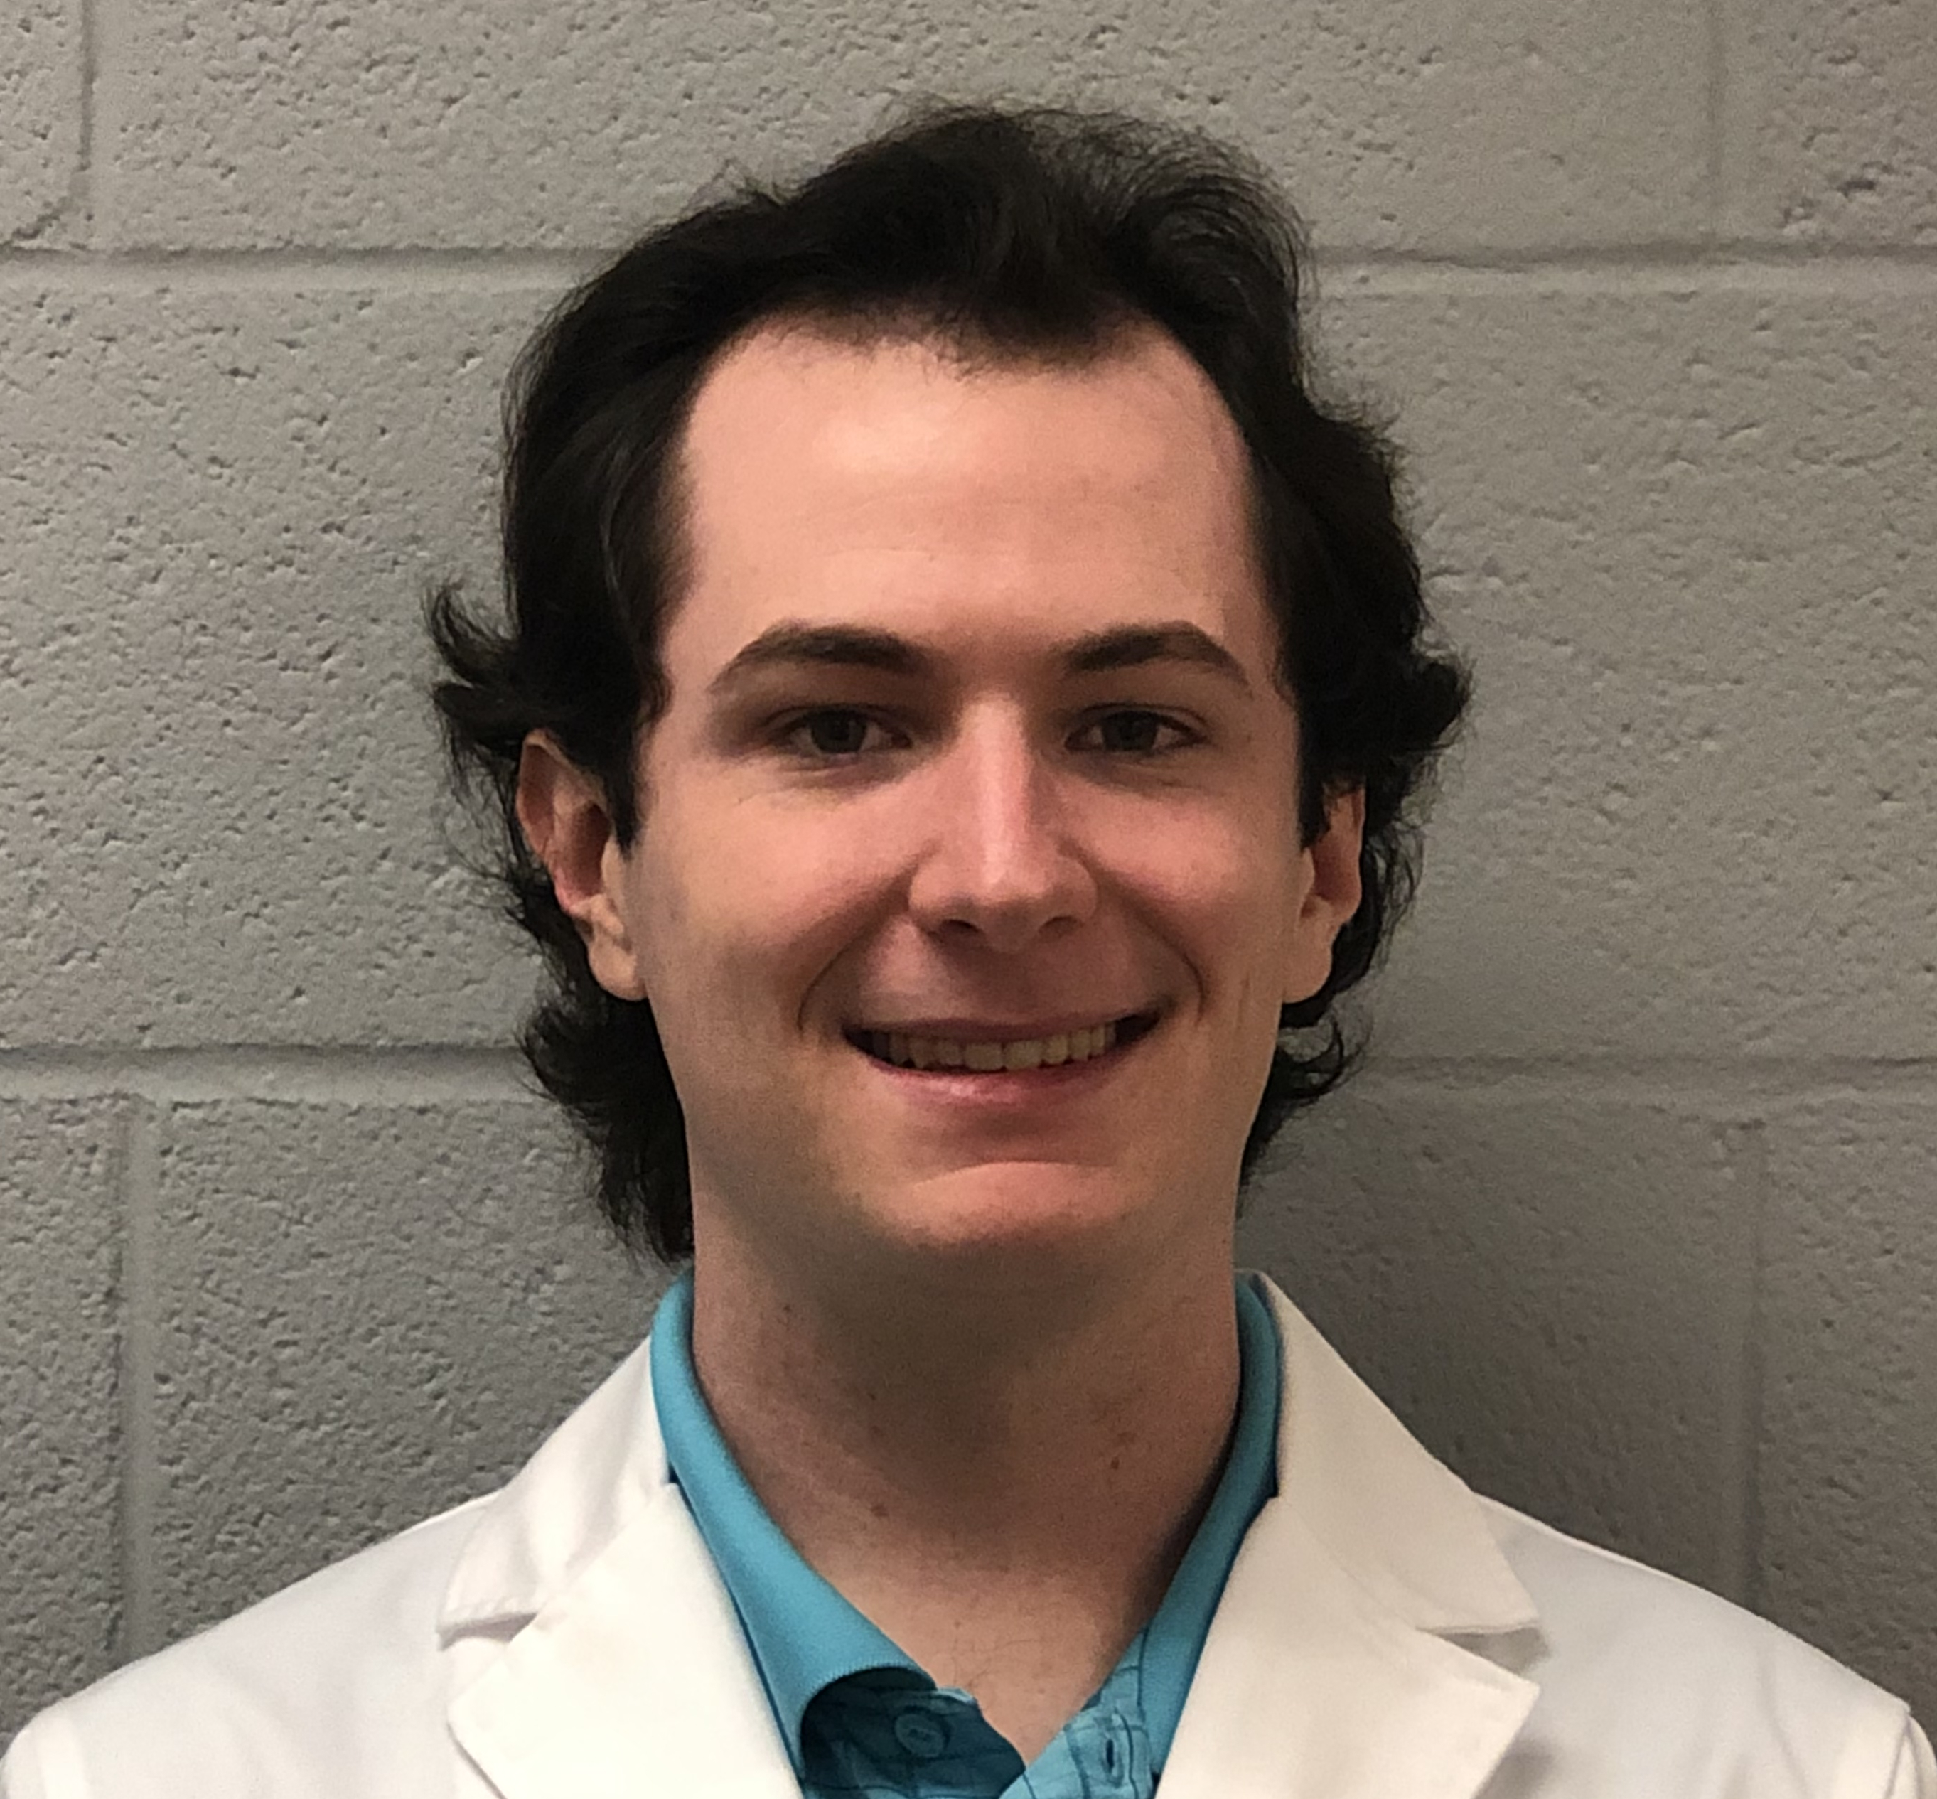

The Plasma for Life Sciences Lab at NC State formed in 2017 to join this growing and diverse field
Dr. Katharina Stapelmann
PLS Lab Director
Duncan Trosan
PhD Student
Medical DBD Characterization
Brayden Meyers
PhD Student
COST Jet Characterization
William Murray
PhD Student
Plasma-Water Treatment
Naveen Pillai
PhD Student
CFD & EM Coupled Simulations
Dr. Pietro Raneiri
Post-Doc Researcher

Slide 4
Plasma can decompose organic compounds in liquids that are difficult to remediate with chemical methods
Chemical Decomposition
Methylene-blue is a dye that is hard to decompose chemically
Plasma treatment decomposes M-B, clearing the solution
Other organics may be decomposed with plasmas by changing plasma settings
Magureanu, Monica, et al. "Decomposition of methylene blue in water by corona discharges." Plasma Chemistry and Plasma Processing 28.6 (2008): 677-688.

Slide 5


Plasma treatment of water is limited by the breakdown voltage of water and contact area with gas
Air: $V_{breakdown}≈3 MV/m$
Water: $V_{breakdown}≈65 MV/m$
P J Bruggeman et al 2016 Plasma Sources Sci. Technol.25 053002

Slide 6
The shape and size of the bubble is strongly correlated to its ability to form a plasma via the E-field profile
Babaeva, Natalia Yu, et al. "Streamer breakdown in elongated, compressed and tilted bubbles immersed in water." Journal of Physics D: Applied Physics 50.36 (2017): 364001.
B S Sommers and J E Foster 2014 Plasma Sources Sci. Technol. 23 015020

Slide 7
Plasma-bubble ignition is coupled with the shape of the bubble, which deforms upon ignition
P J Bruggeman et al 2016 Plasma Sources Sci. Technol.25 053002

Slide 8
The purpose of this research is to characterize large-scale plasma-bubble chambers for water treatment
First Plasma
(Fall 2019)
Chemical Analysis
(Spring 2020)
PhD Thesis (2022)
Parts acquisition & manufacturing
Iterative R&D changes based on bubble, plasma, and chemistry results
Applications testing (sterilization, nitrate production, decomposition of organic compounds, etc.)
Initial Chamber Design [WITCH]
(Fall 2018)
First Bubbles
(Summer 2019)

Slide 9
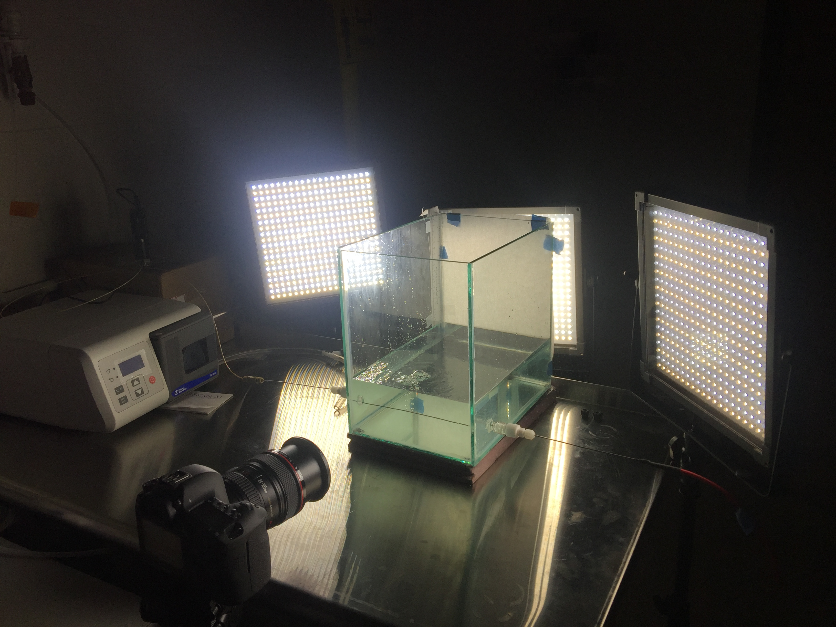
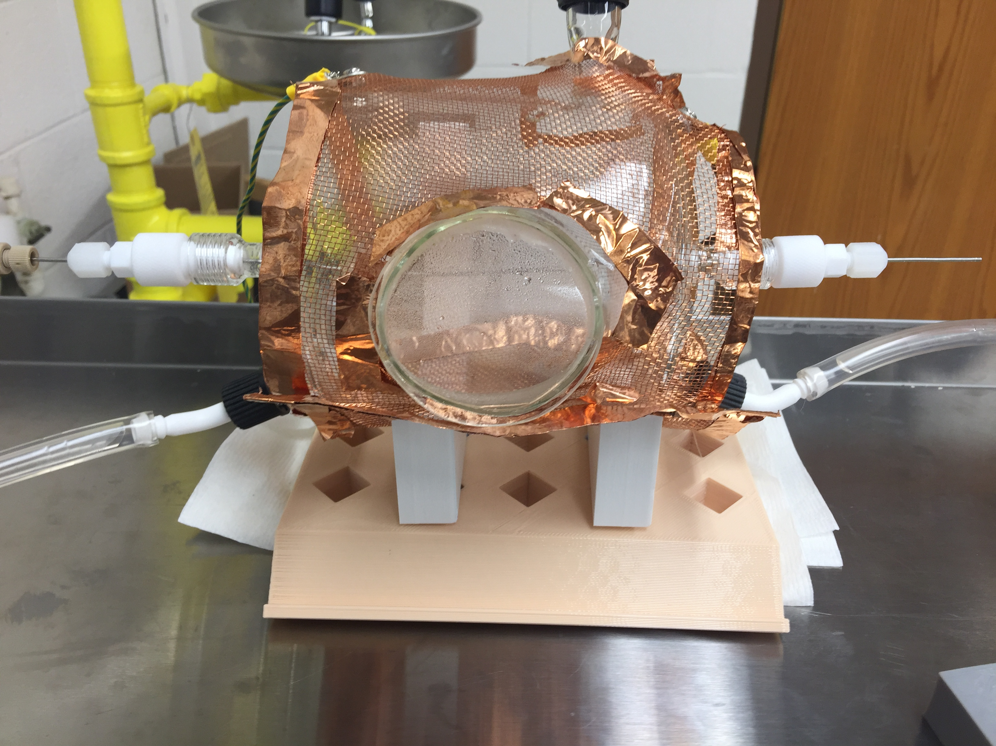
Two bubble chambers have been created to study plasma behavior in bubbles
CAULDRON – Bubble Characterization Chamber
WITCH – Plasma Treatment Chamber

Slide 10
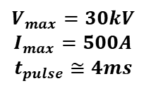
The WITCH ignites plasma with a high voltage potential arranged in a barrel-capacitor configuration
Streamer
Discharge Path
Copper Mesh
Gas Bubbles
Capillary Tube
$$V_{max}=30kV$$
$$I_{max}=500A$$
$$t_{pulse}≅4ms$$
WITCH:
“Water Ionization Two-phase Chamber”

Slide 11
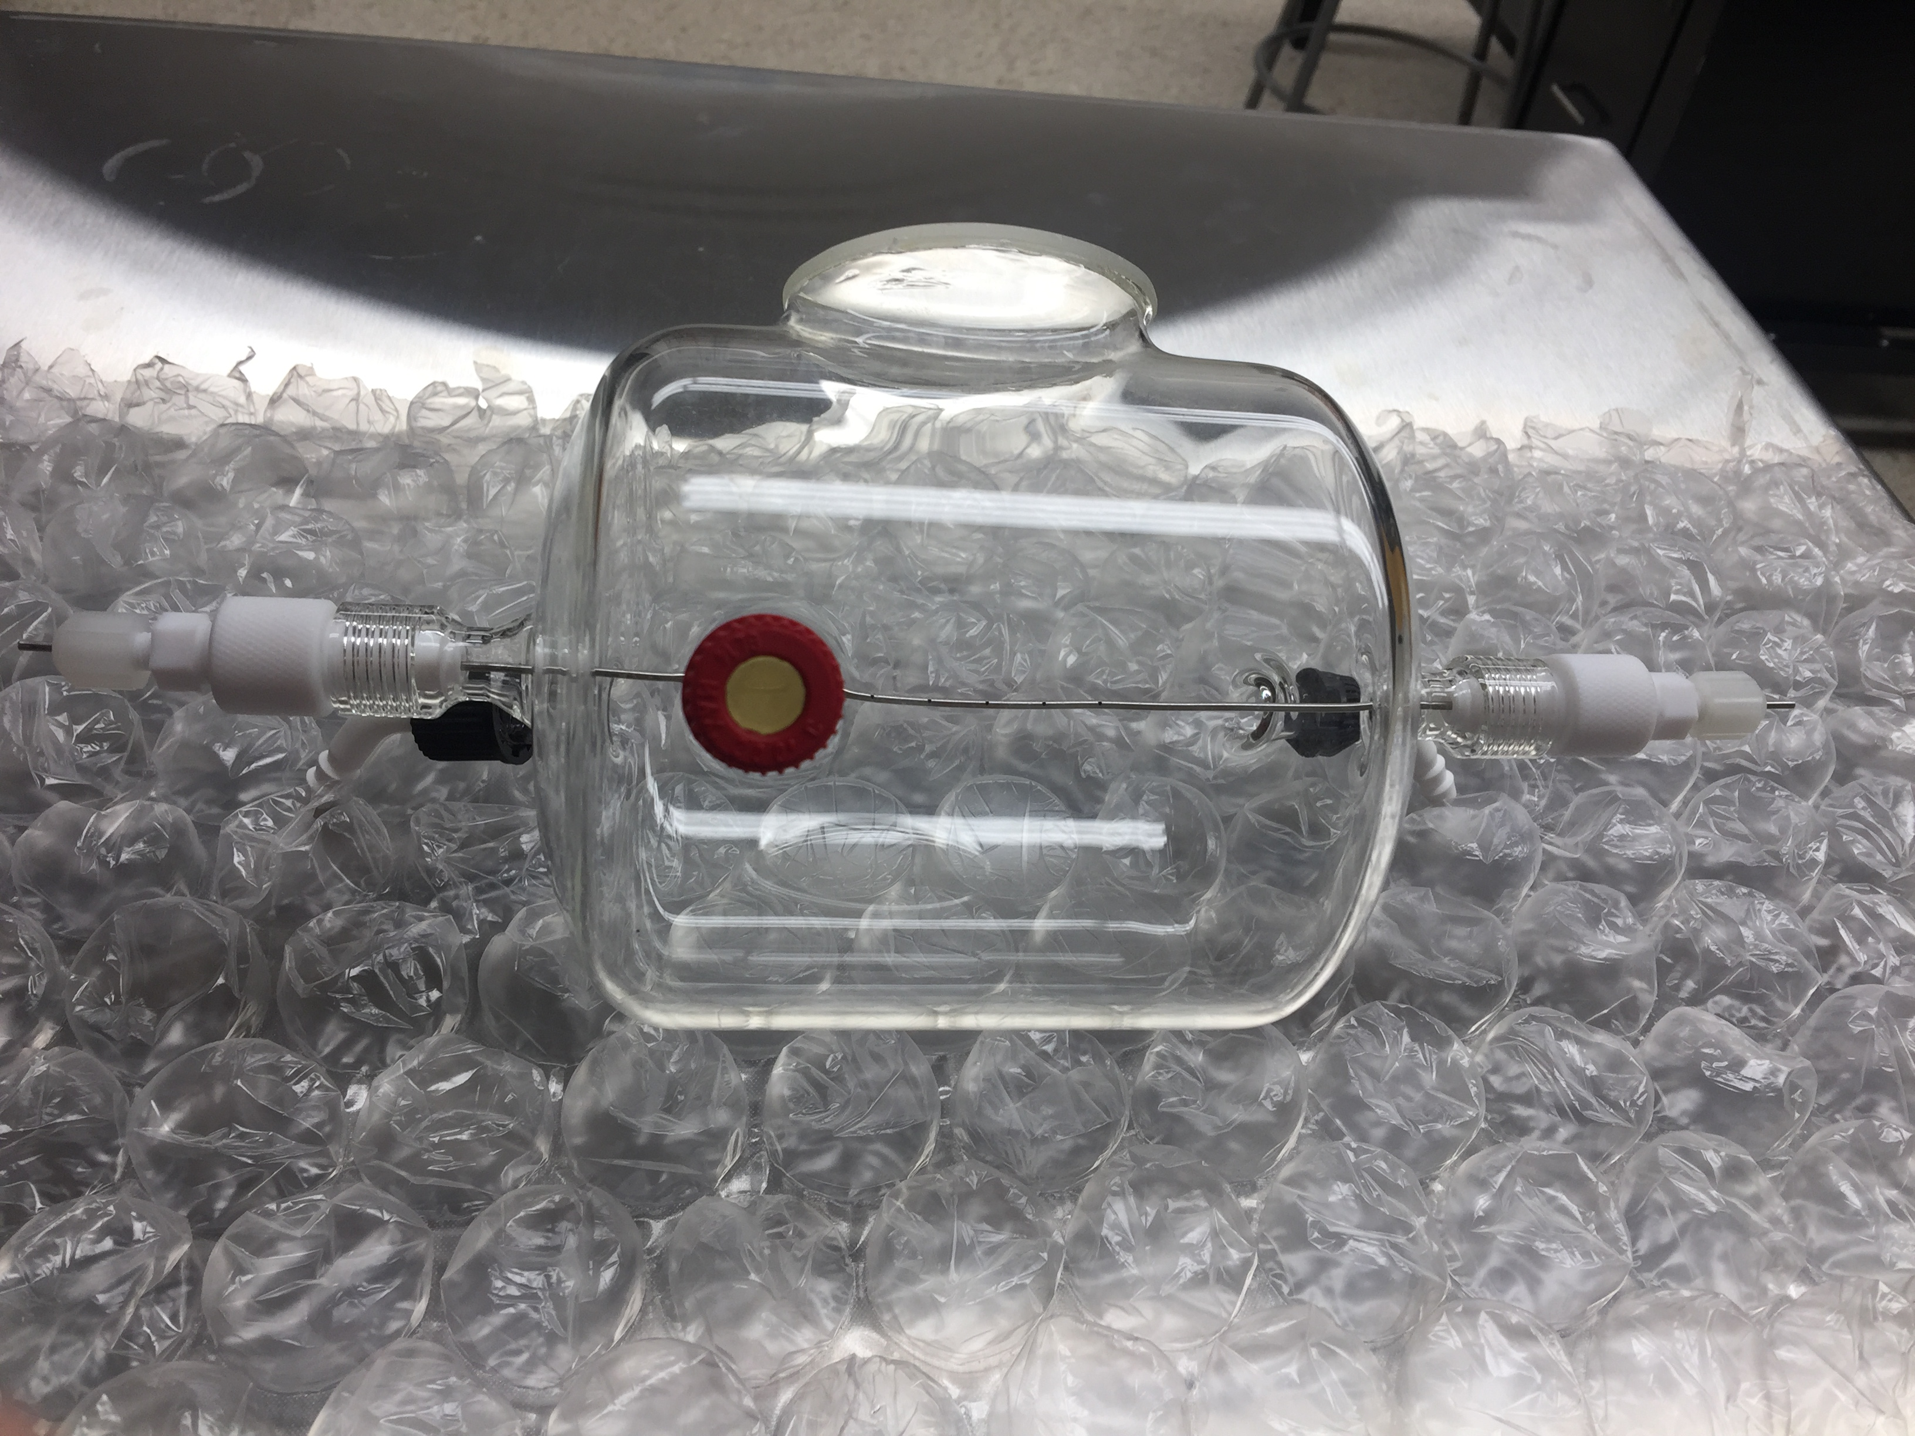
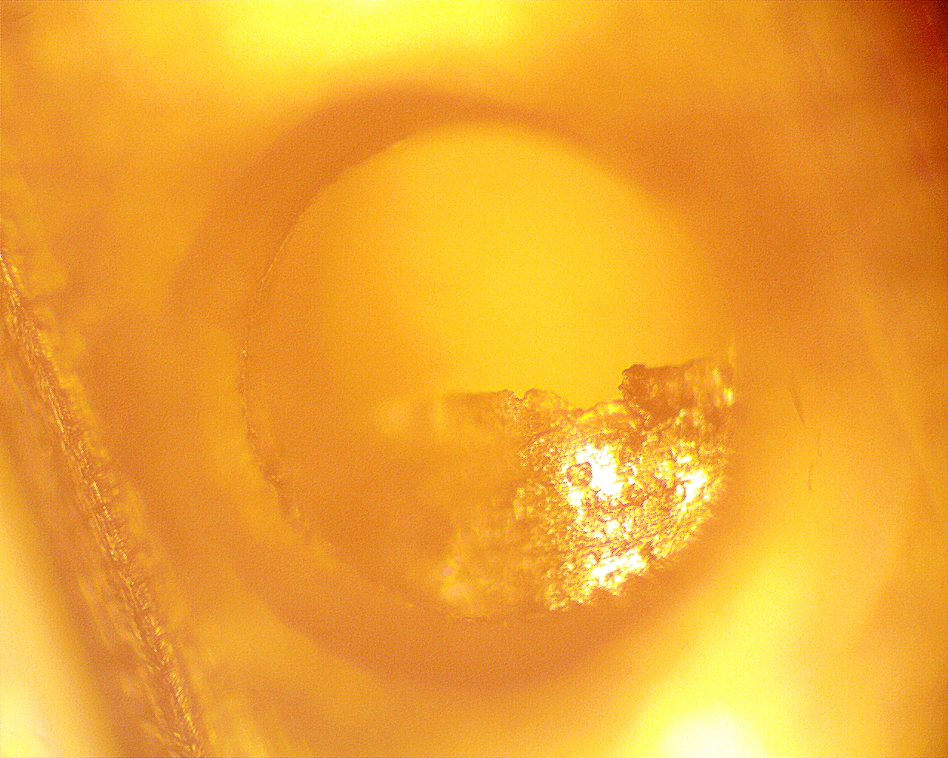
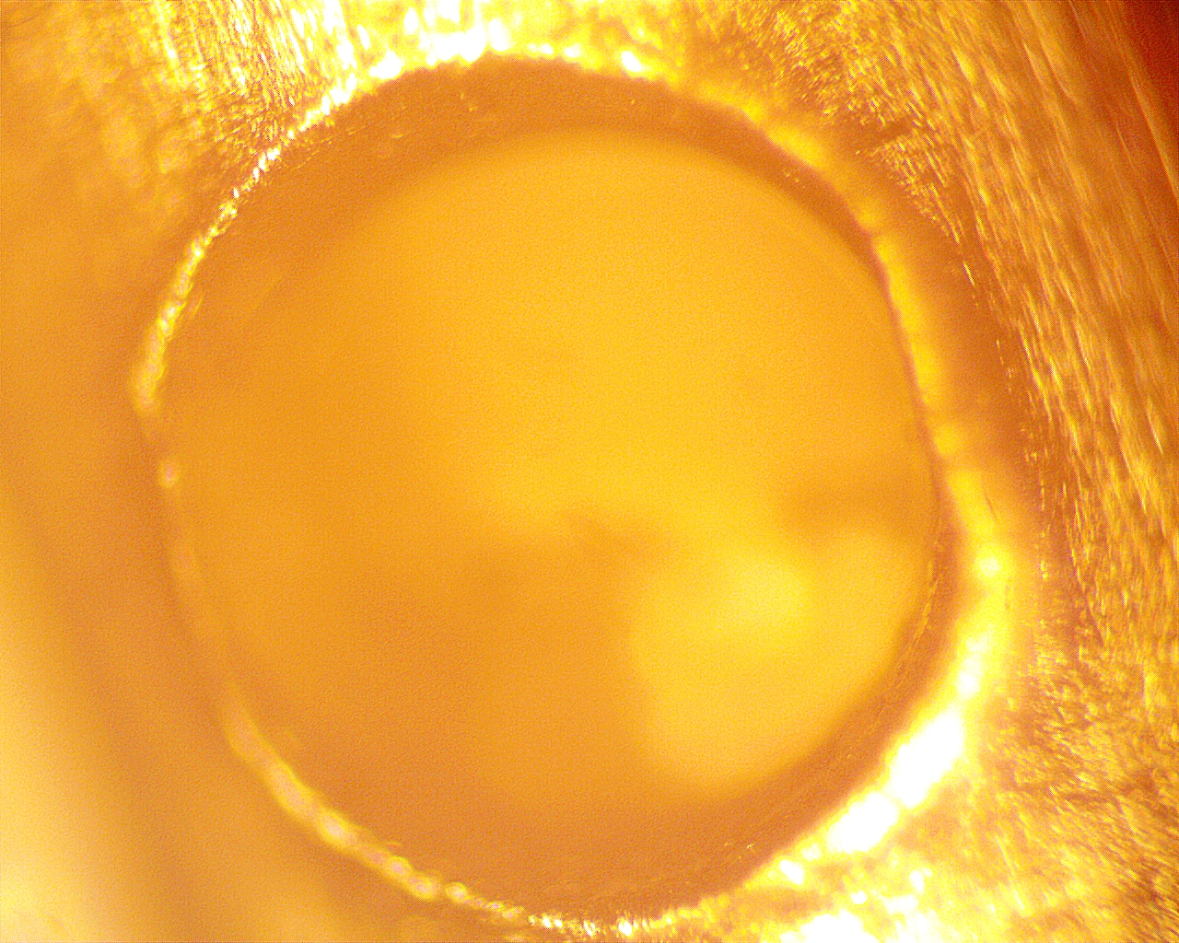
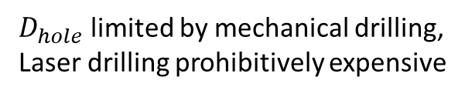

The capillary tubes are small to mimic the behavior of a wire, and are perforated with small holes for the gas
$D_{hole}$ limited by mechanical drilling,
Laser drilling prohibitively expensive
$$D_{hole}≅0.5mm$$

Slide 12
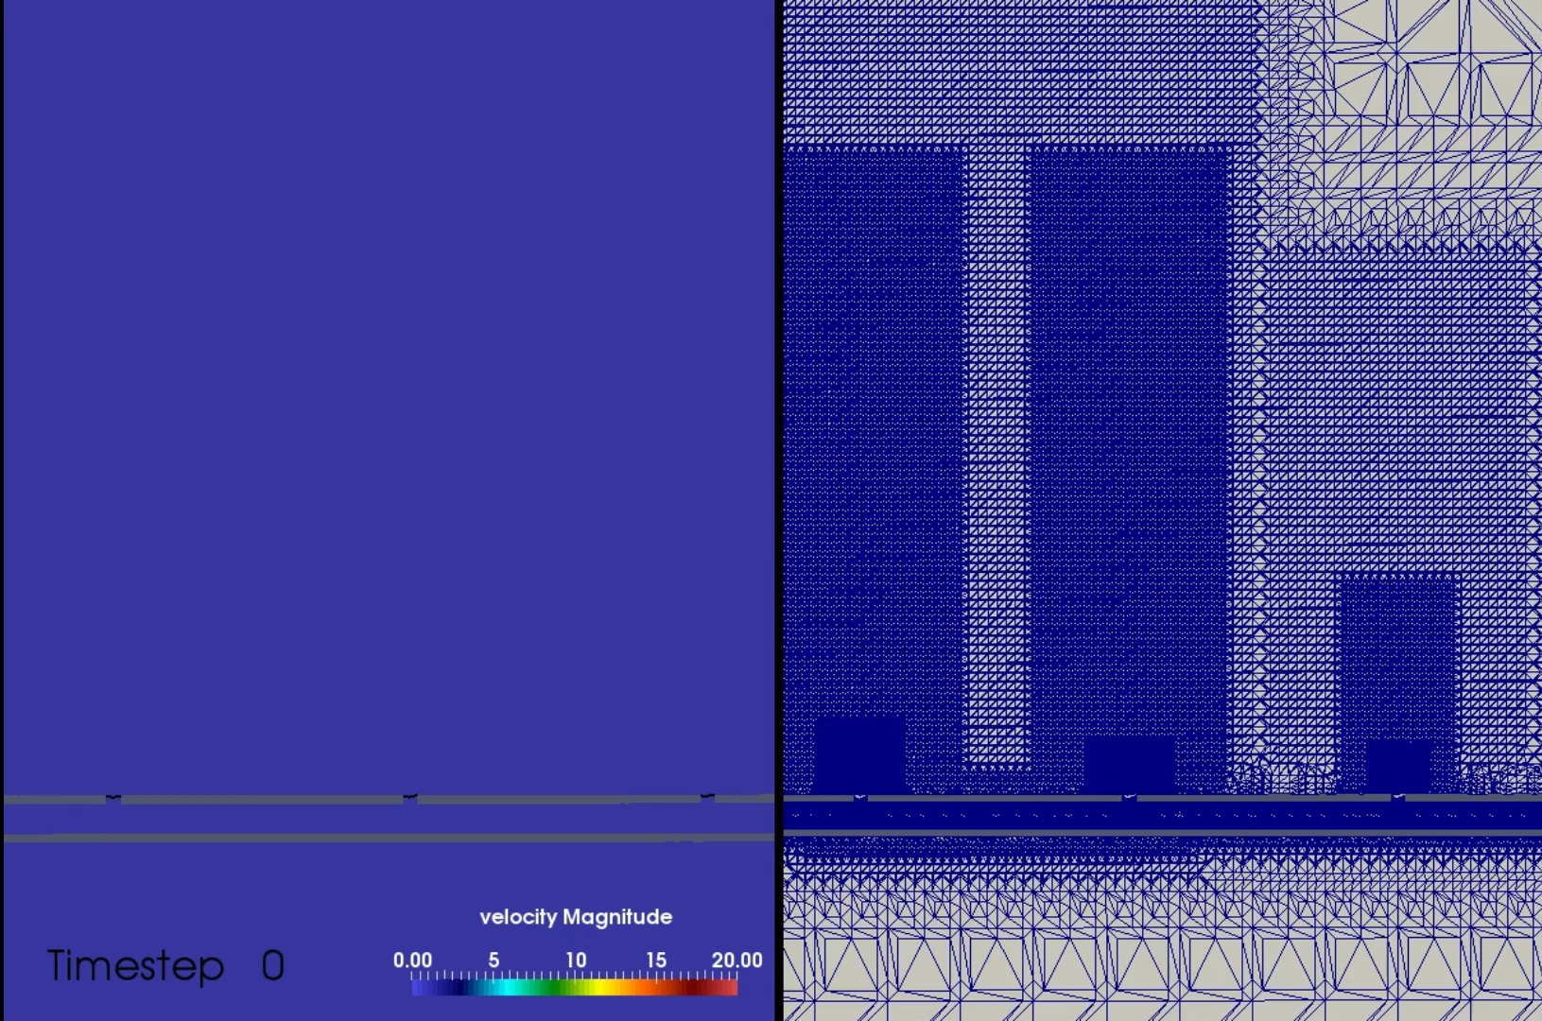
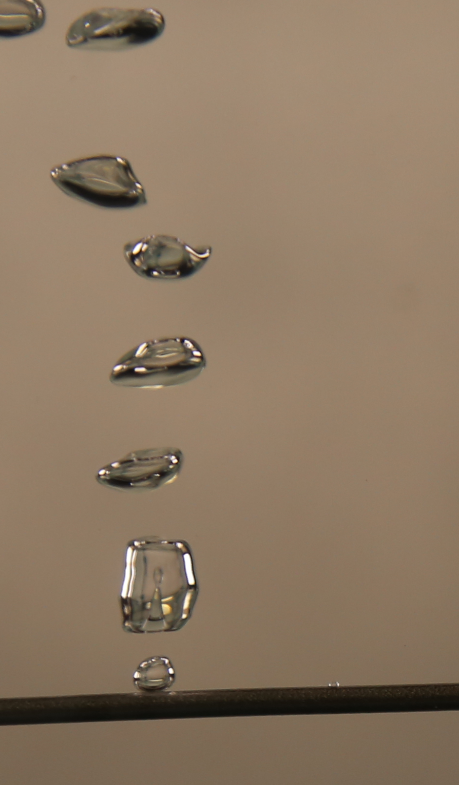
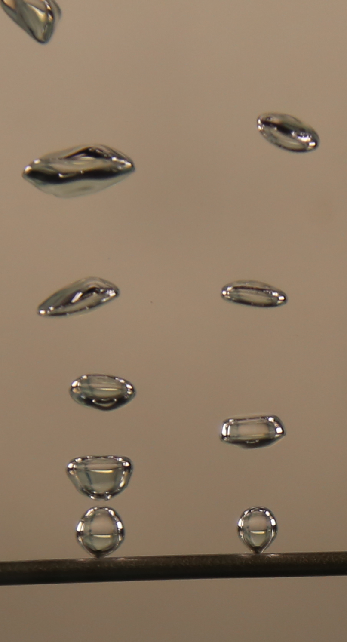
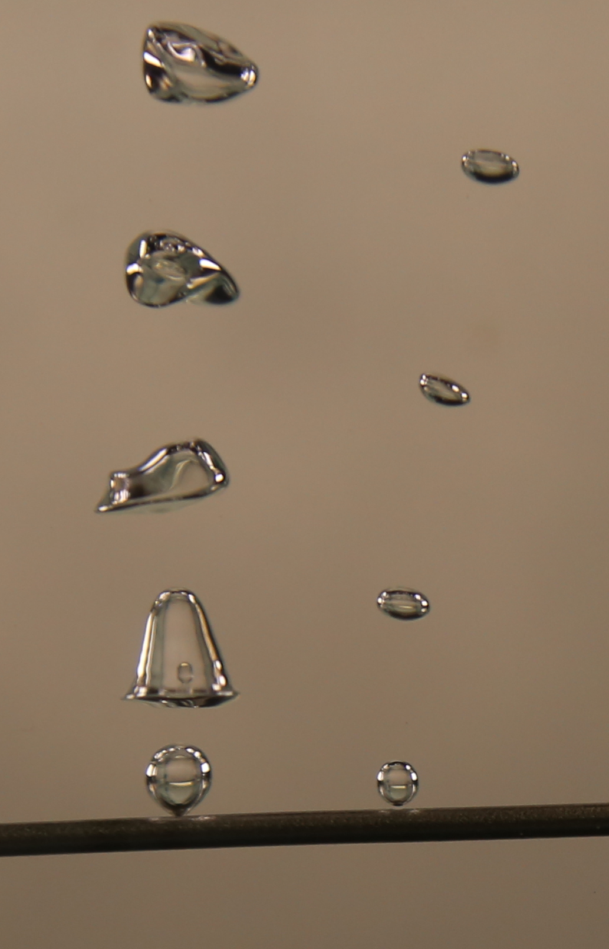
CFD simulations are also in place to assist in design of tube to obtain desirable bubbles for plasma ignition
Courtesy: Naveen Pillai
CFD Simulation of Tube (sequential snapshots)
CAULDRON Photographs (arbitrary snapshots)

Slide 13

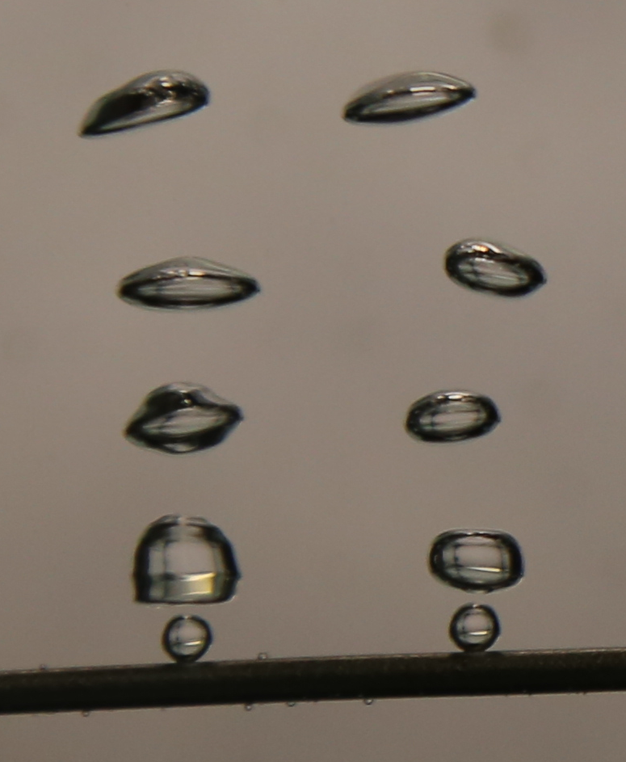
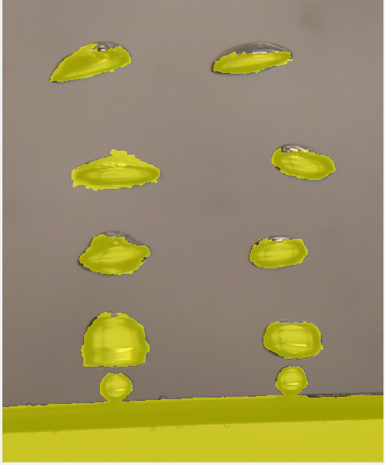

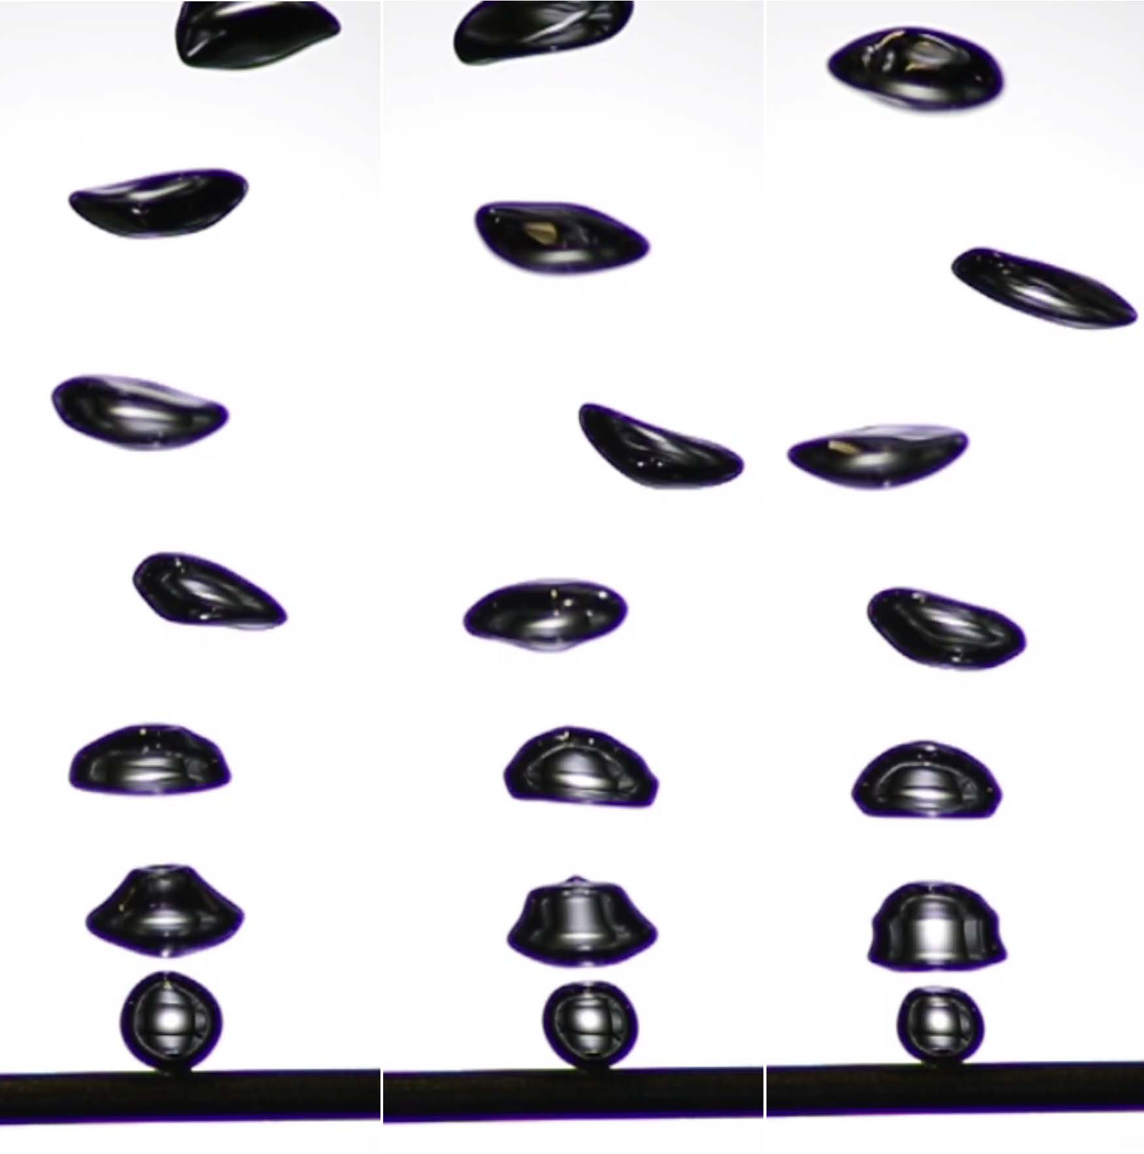
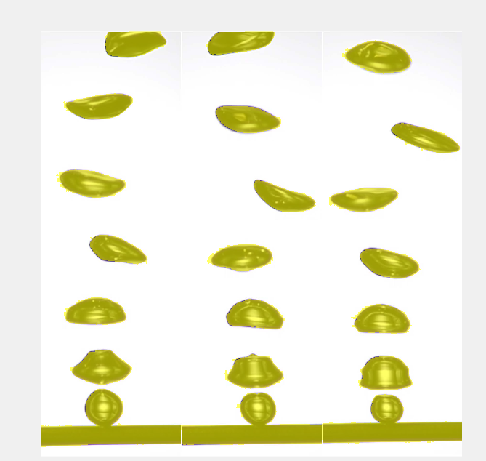

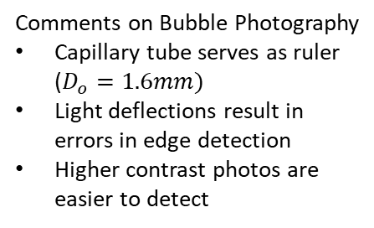
Image processing is done in MATLAB to identify and count bubbles seen in each photograph
Murray (2019)
Comments on Bubble Photography
Capillary tube serves as ruler ($D_{o}=1.6mm)$
Light deflections result in errors in edge detection
Higher contrast photos are easier to detect
Ratering (2018)
Ratering, Caroling. “Konstruktion Und Charakterisierung Eines Plasma-Wasser-Aufbaus.” Ruhr-Universität Bochum, 2018.

Slide 14
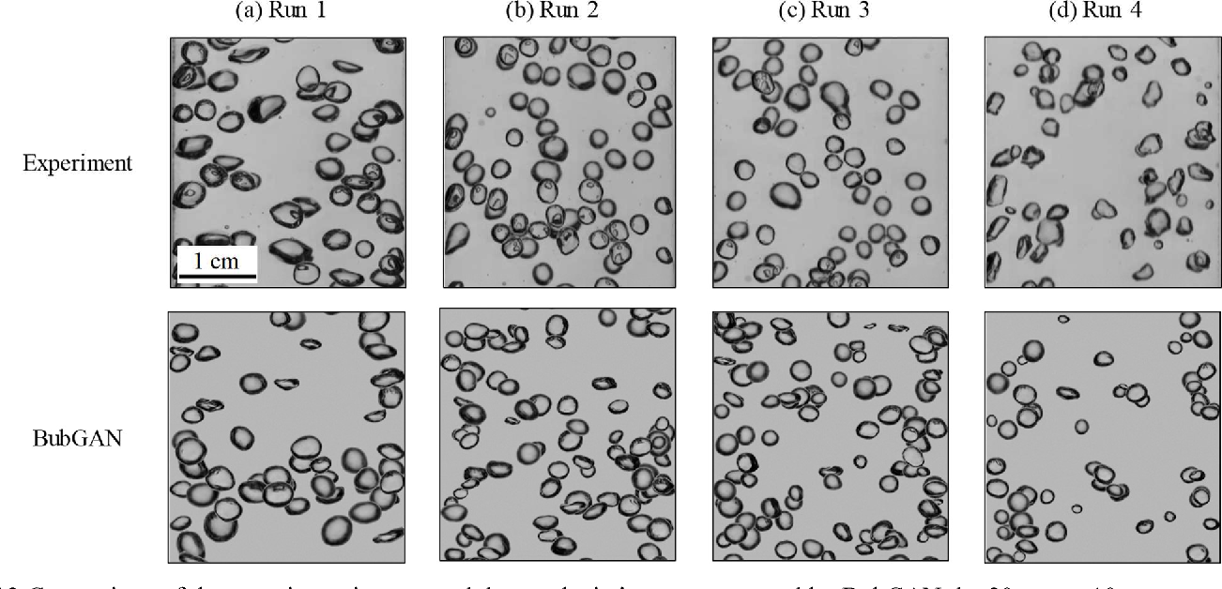
Machine learning looks promising to supplement traditional image processing for bubble analysis
Original image
Producing artificial bubbles with AI
to create testing data for ML bubble recognition
CNN Processing
ML bubble identification
Fu, Yucheng, and Yang Liu. "BubGAN: Bubble generative adversarial networks for synthesizing realistic bubbly flow images." Chemical Engineering Science 204 (2019): 35-47.
Poletaev, I. E., K. S. Pervunin, and M. P. Tokarev. "Artificial neural network for bubbles pattern recognition on the images." Journal of Physics: Conference Series. Vol. 754. No. 7. IOP Publishing, 2016.

Slide 15
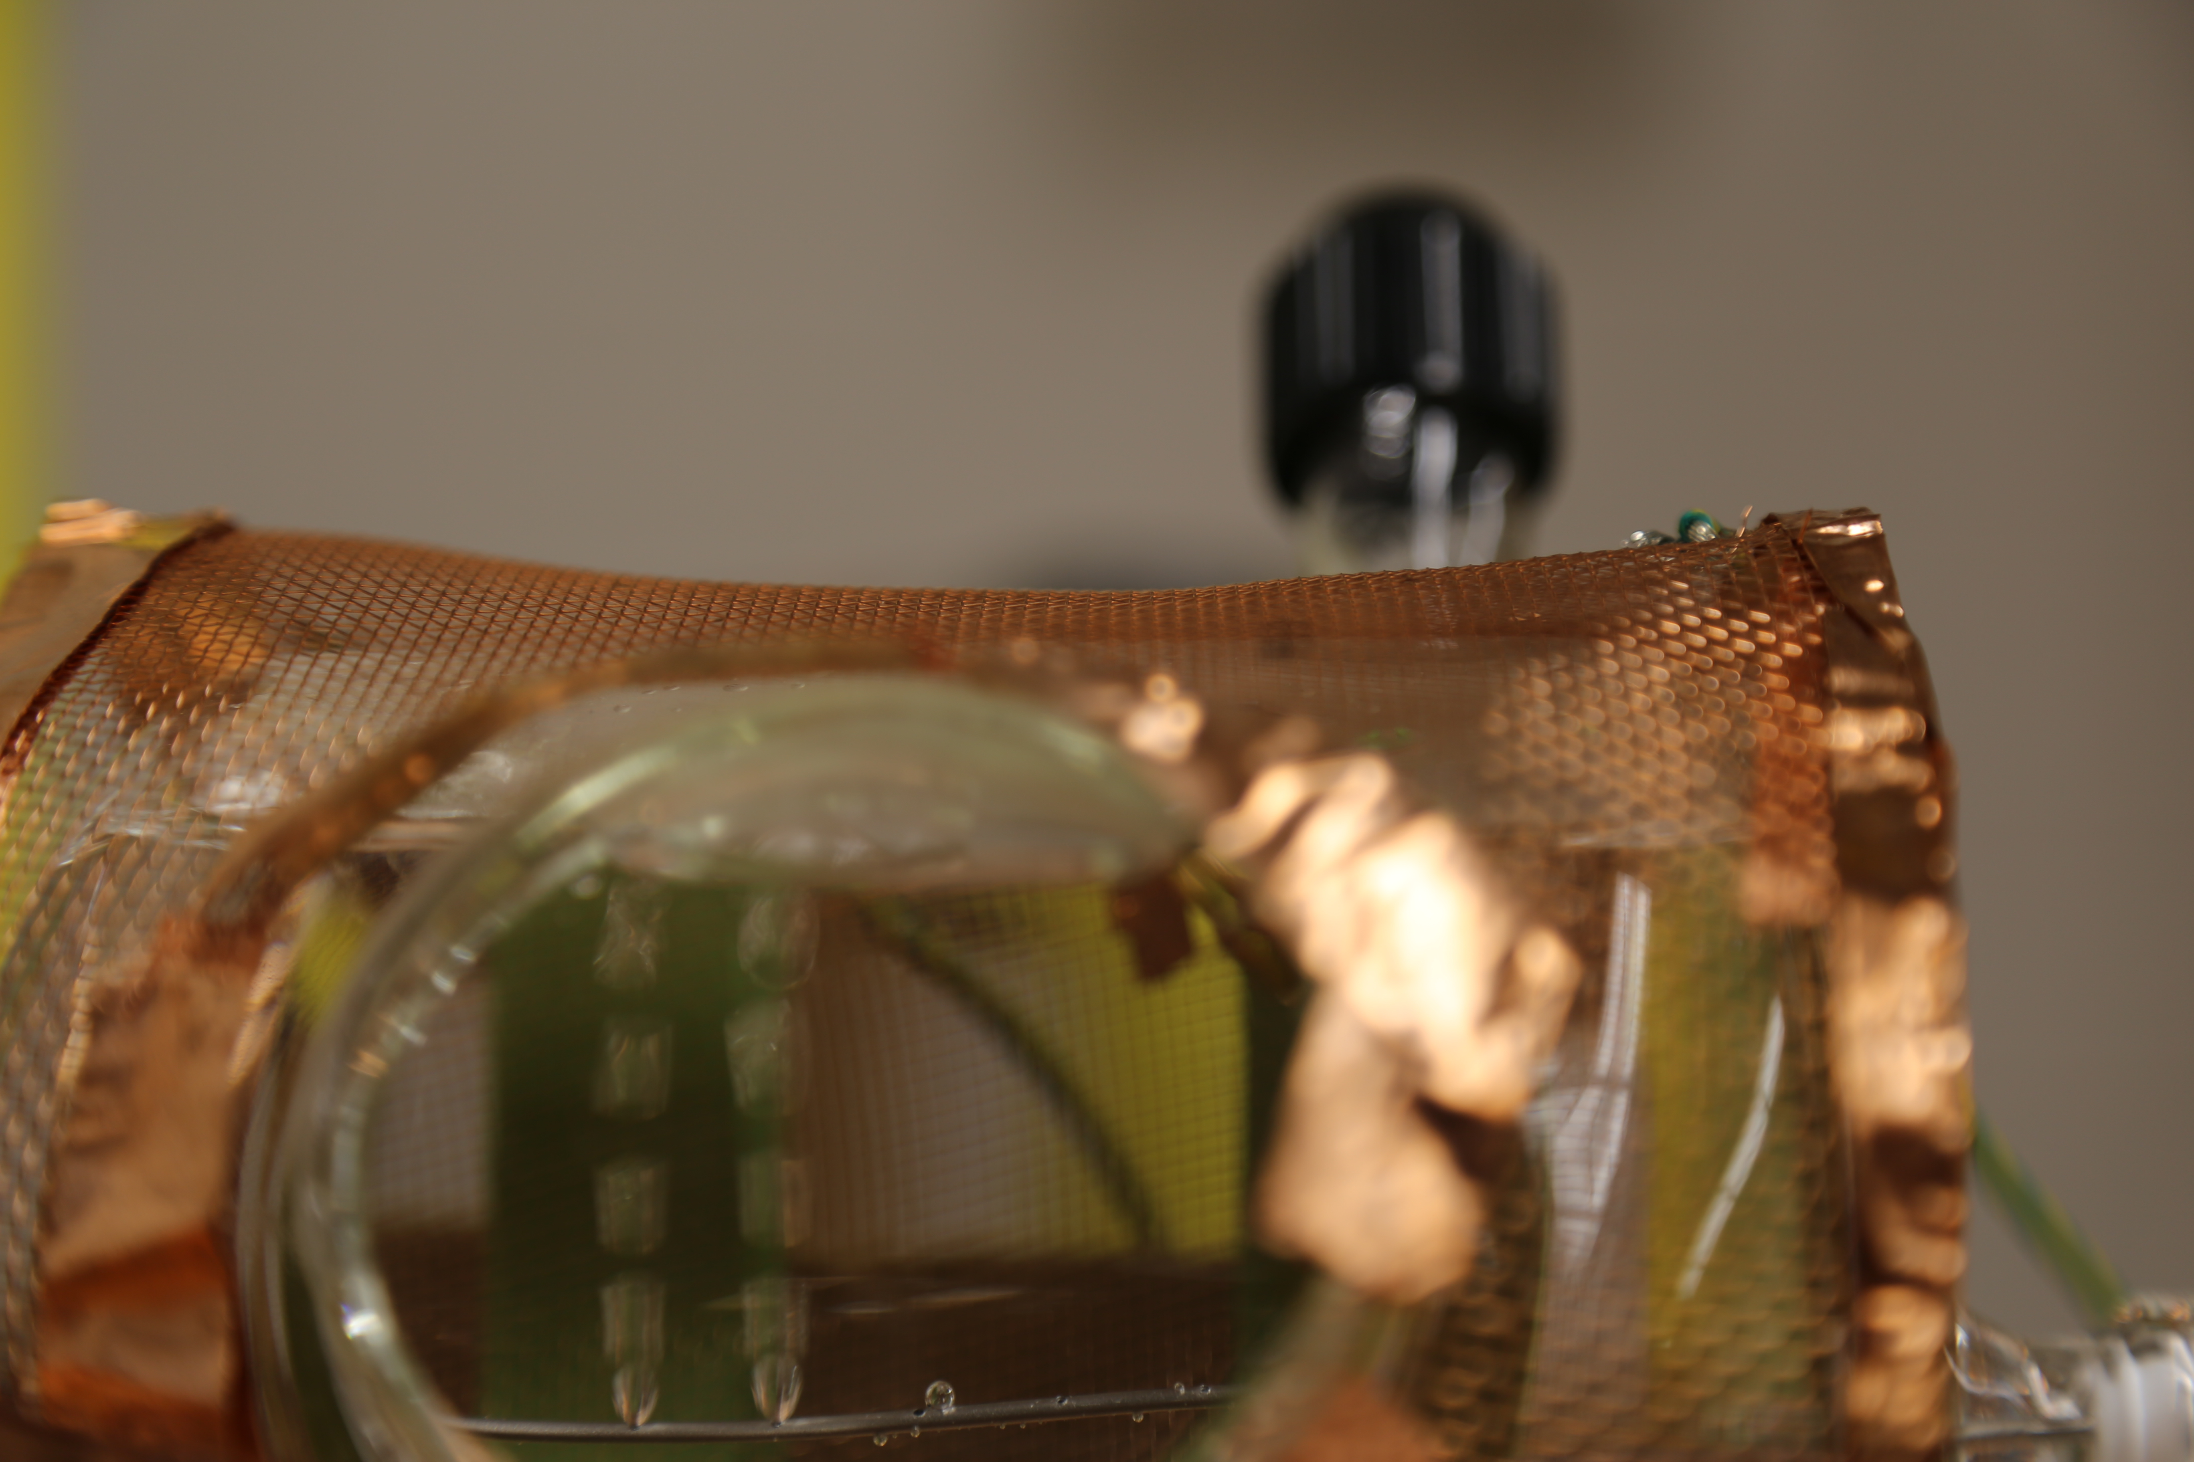
The WITCH & the CAULDRON will combine plasmas with fluid mechanics to improve the throughput of liquid-plasma systems
Contact Information
Name: William Murray
Email: wrmurray@ncsu.edu
Affiliation: NCSU-NE Plasmas for Life Sciences
Address: 2500 Stinson Drive, Raleigh, NC 27607
Now open for questions,
comments, and suggestions
Final Remarks & Contact

